Slide 1
Loading data from Json data from blob to the Snowflake Raw layer using adf.

Slide 2
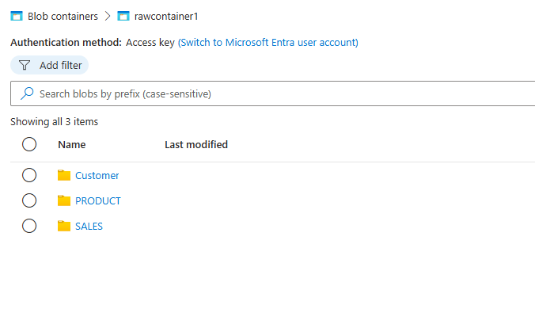
Blob container where data is present.

Slide 3
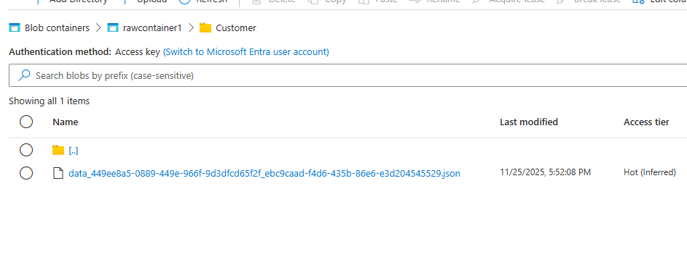

Slide 4
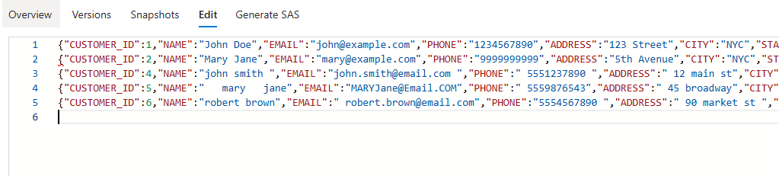

Slide 5
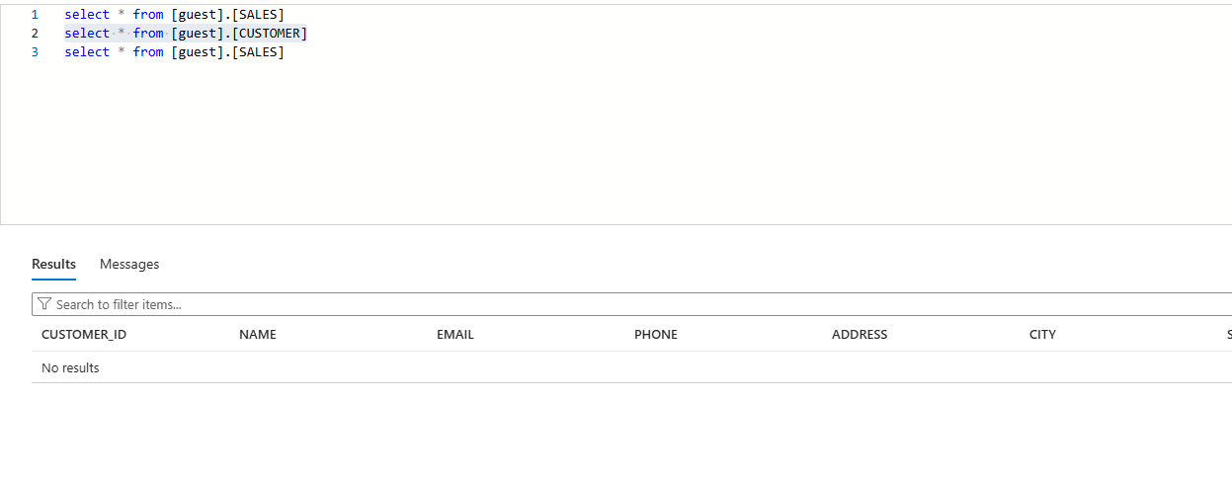
Target table empty

Slide 6
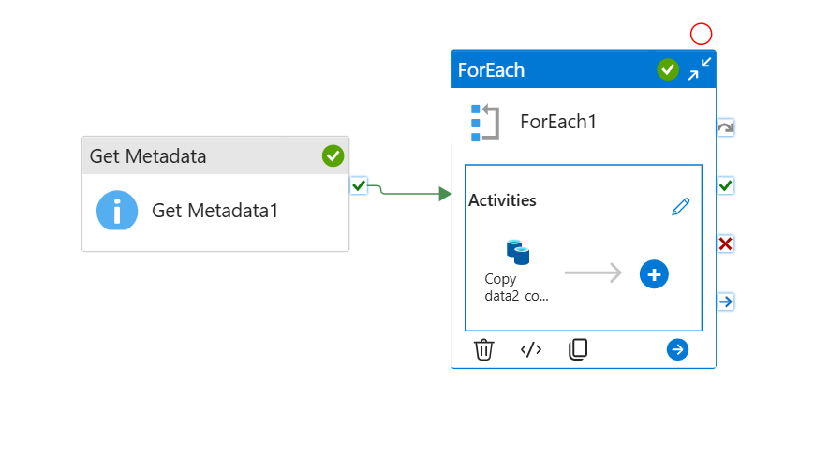

Slide 7
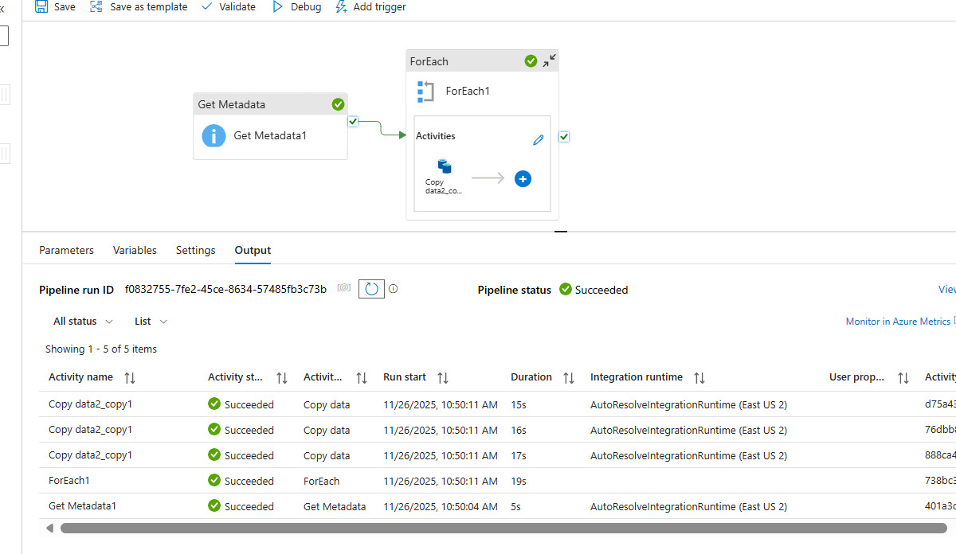

Slide 8
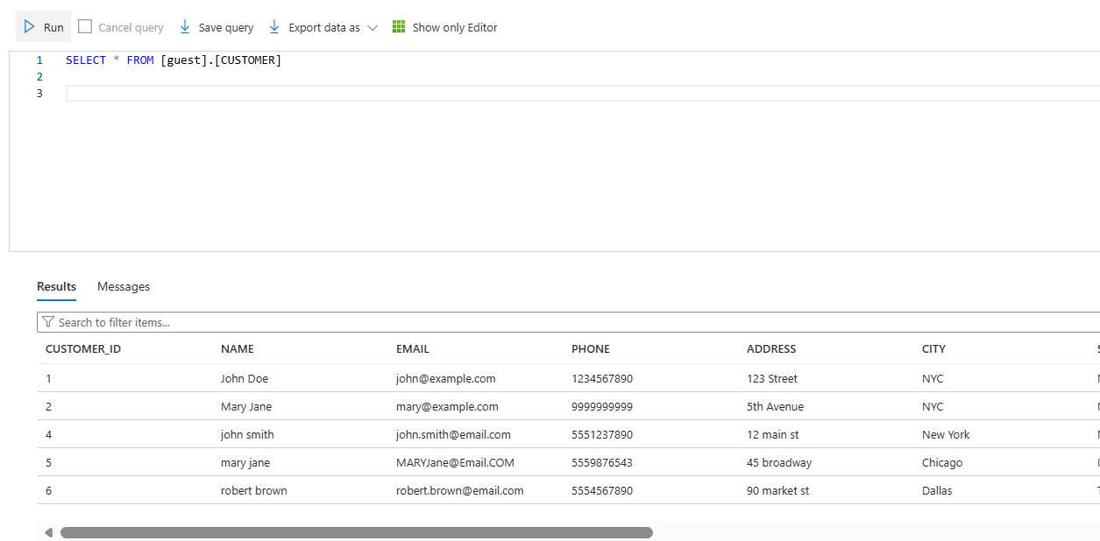

Slide 9
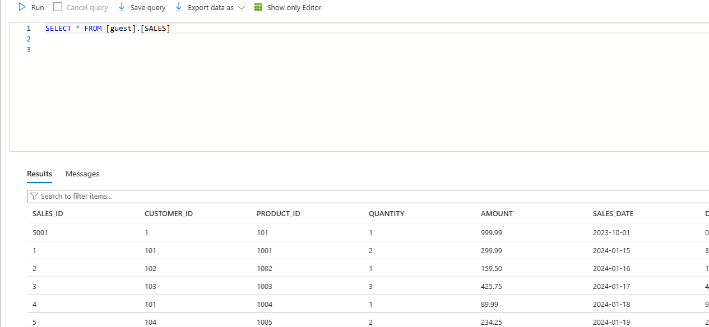

Slide 10
Advantages
• Fully Automated - Zero manual intervention required
• Time Efficient - Processes data 24/7 automatically
• Scalable - Handles unlimited data growth
• Cost Effective - Reduces operational costs by 80%
• Reliable - Ensures data consistency and accuracy

Slide 11
Conclusion
Successfully implemented an automated, scalable data pipeline that delivers reliable, cost-effective data ingestion with minimal maintenance.

